Slide 1



Developing Hyperledger Applications
Building Enterprise Blockchains
Lennart Frantzell
IBM Developer Advocate
San Francisco
alf@us.ibm.com
Blockchain Explored Series
IBM Blockchain Platform Explored
Architectures Explored
Fabric Explored
Composer Explored
What’s New
V1.2 February 1 2019
Notes:
This is a technical dive into blockchain architectures. Presentations in the “Explored” series are:
IBM Blockchain Platform Explored: How the IBM Blockchain Platform works.
Architectures Explored: Good blockchain architectures
Fabric Explored: Technical dive on Hyperledger Fabric
Composer Explored: Technical dive on Hyperledger Composer
What’s New: Recent developments in Fabric, Composer and IBP.

Slide 2
Introduction

Slide 3
Build for free on IBM Cloud:
https://ibm.biz/Bd2L5W

Slide 4
What makes a good Blockchain Use Case?
A Business problem that cannot easily be solved with existing techniques
An identifiable business network
With a shared ledger
With Participants, Assets and Transactions
A need for embedded trust but no Trusted Third Party
Consensus, Immutability, Finality and Provenance

Slide 5
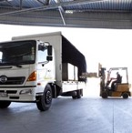

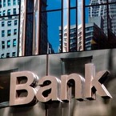




A shared, replicated, permissioned ledger …
Participant B’s records
Participant A’s records
Bank records
No trusted
Third party,
No need
for reconciliation
Blockchain
Insurer records
Regulator records
Auditor records
… with consensus, provenance, immutability and finality
Notes:
The novel Blockchain architecture give participants the ability to share a ledger which is updated every time a transaction occurs through peer to peer replication.
Cryptography is used to ensure that network participants see only the parts of the ledger that are relevant to them, and that transactions are secure, authenticated and verifiable.
Blockchain also allows the contract for asset transfer to be embedded in the transaction database determining the conditions under which the transaction can occur.
Network participants agree how transactions are verified through consensus or similar mechanisms. Government oversight, compliance & audit can be part of the same network.
Participants SAME AS BEFORE – this is not a disintermediation play
CONSENSUS– means all participants agree that a transaction is valid
PROVENANCE– means participants know where the asset came from and how it’s ownership has changed over time
IMMUTABILITY– means no participant can tamper with a transaction once it’s agreed. If a transaction was in error then a NEW transaction must be used to reverse the error, with both visible
FINALITY– means that there is ONE place to determine the ownership of an asset or completion of a transaction. This is the role of the SHARED LEDGER.

Slide 6

Spectrum of Blockchains
Permissionless Public | Permissionless Private | Permissioned Public | Permissioned Private
Bitcoin, Ethereum | Public Polls | Land Titles, University Degrees | Business Apps Medical Records
Permissioned vs. Permissionless: Who can write to a Blockchain, i.e. accessibility
Public vs Private: who can read from a Blockchain, i.e. visibility
https://www.youtube.com/watch?v=-O3ouBdG3Xg

Slide 7
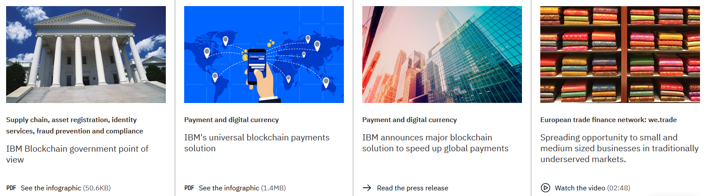
Re-use existing Blockchain Use Cases
https://www.ibm.com/blockchain/use-cases/

Slide 8
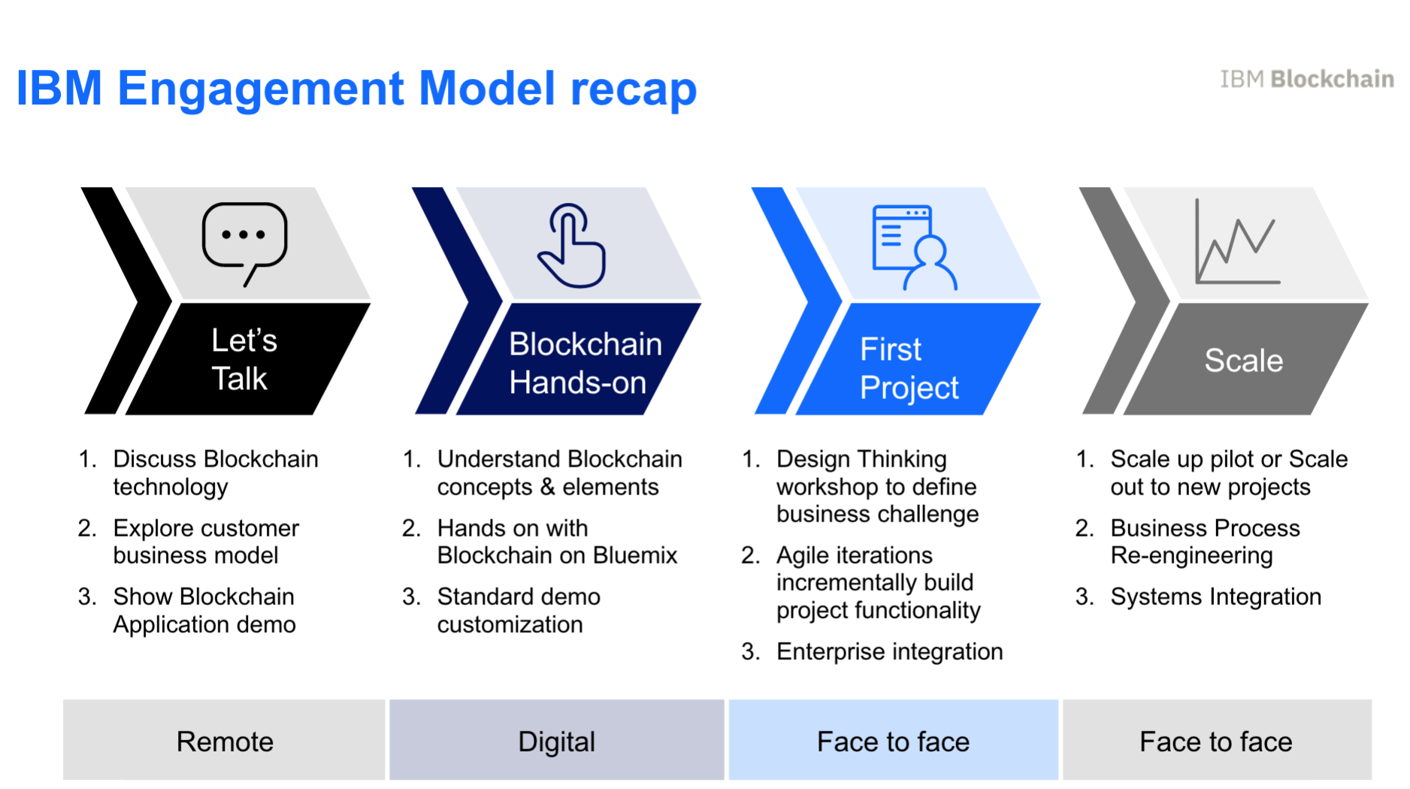
IBM Engagement Model recap

Slide 9
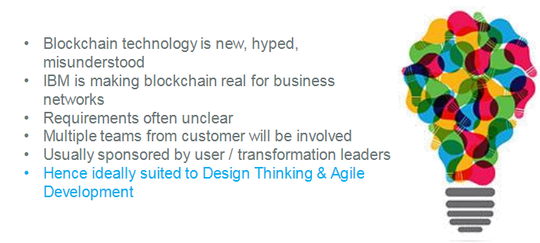
Design Thinking
https://www.ibm.com/design/thinking/

Slide 10
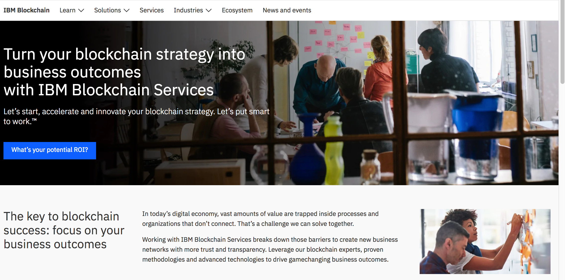
Blockchain Garage
https://www.ibm.com/blockchain/services

Slide 11
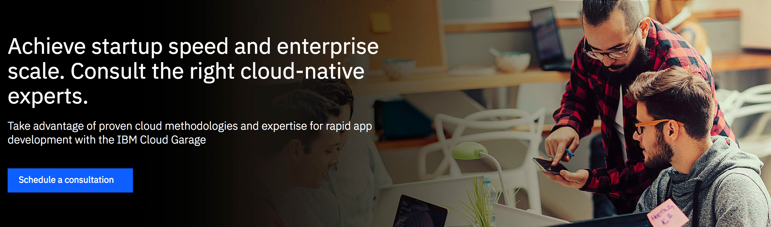
Cloud-native: A journey to agile application development
https://www.ibm.com/cloud/cloud-native/ibm-cloud-garage

Slide 12
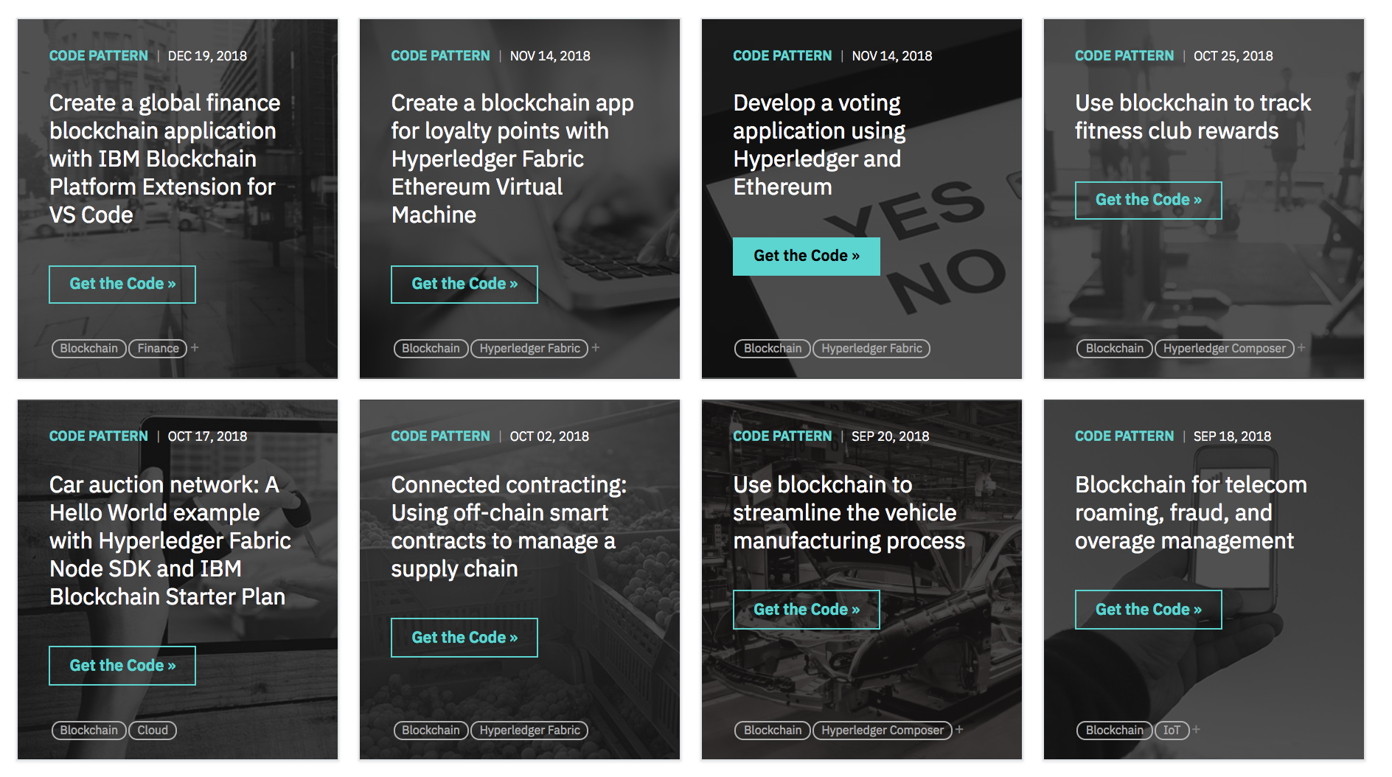
IBM Design Code Patterns for Blockchain
IBM Code Patterns for Blockchain: https://developer.ibm.com/patterns/category/blockchain/
10 Lessons: Design Thinking for Blockchain
https://www.ibm.com/blogs/insights-on-business/government/10-lessons-design-thinking-blockchain/

Slide 13

Supply Chain, the poster child of Blockchain
Sourcing
Manufacturing
Warehousing
Distribution
Amazon
Apple
3. ….
The book takes the form of a global travelogue ranging from Atlantic Bluefish Tuna fishermen in Gloucester, Massachusetts, to Japan’s Tsukiji fish market in Tokyo, to tuna pirates in the Mediterranean, to an Austin, Texas sushi bar, to the global restaurant empire of Nobu Matsuhisa and the tuna ranchers of Port Lincoln, South Australia
https://en.wikipedia.org/wiki/The_Sushi_Economy

Slide 14
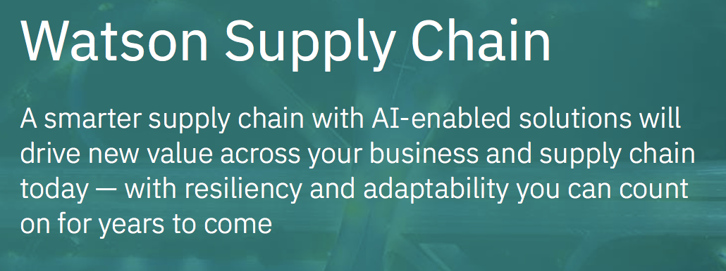
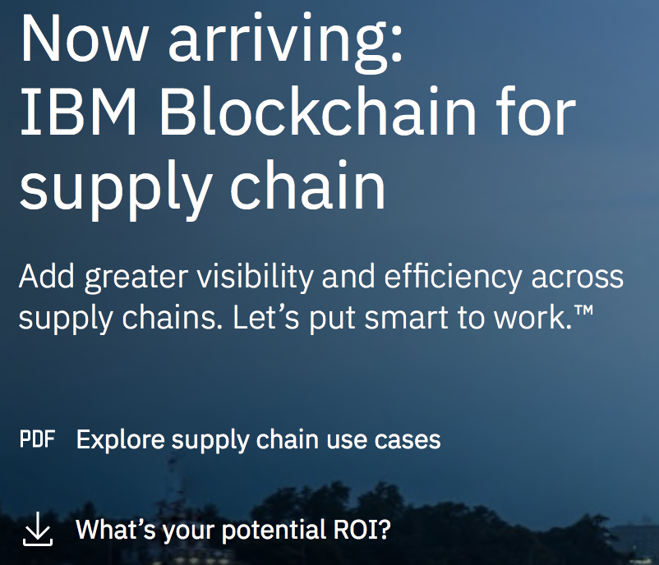

Slide 15
Blockchain and Supply Chain
Using a consortium based model, DLT provides the ability to follow a product from inception to end point delivery while maintaining an appropriate degree of control and information availability to the consortium members.
The three main components (end-end traceability, physical characteristics and regulatory concerns) can be properly accounted for through ensuring the permissions and access required of each entity (e.g., regulator, customer, partner, producer etc.)
https://wiki.hyperledger.org/_media/groups/requirements/hyperledger_-_supply_chain_traceability-_anti_counterfeiting.pdf

Slide 16
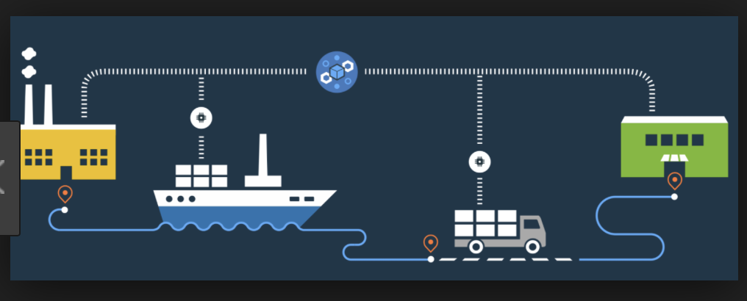
Blockchain, IoT and Smart Contracts in Supply Chain

Slide 17
On-chain/Off-chain/Oracles
Accessing existing data off-chain
https://developer.ibm.com/tutorials/cl-extend-blockchain-smart-contracts-trusted-oracle/
Oracles
Augur
Prediction Market
Game Theory
Human Oracles
https://developer.ibm.com/tutorials/cl-extend-blockchain-smart-contracts-trusted-oracle/

Slide 18
Off chain, the problem with the Systems of Record
All data can not be stored on the Blockchain
Example X-ray images
Diamonds
Art works
Automobiles
Aircraft parts
Food

Slide 19
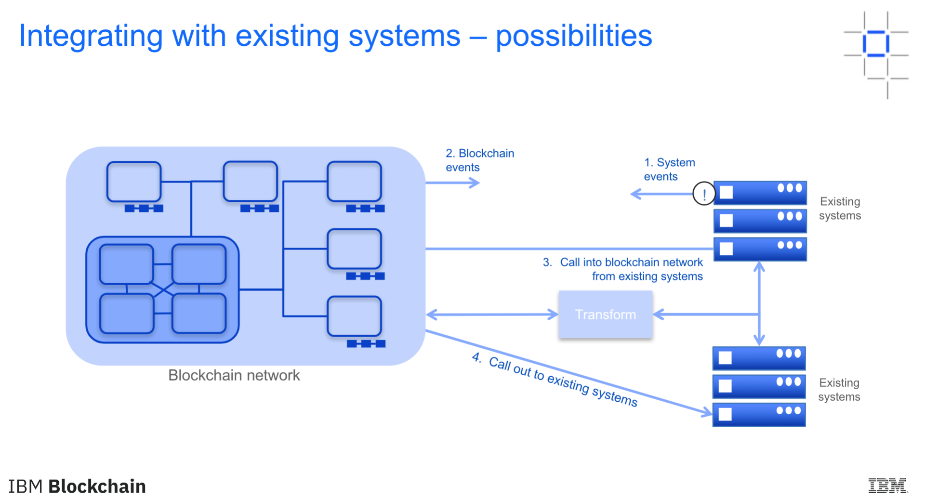
Integrating with existing systems - possibilities

Slide 20
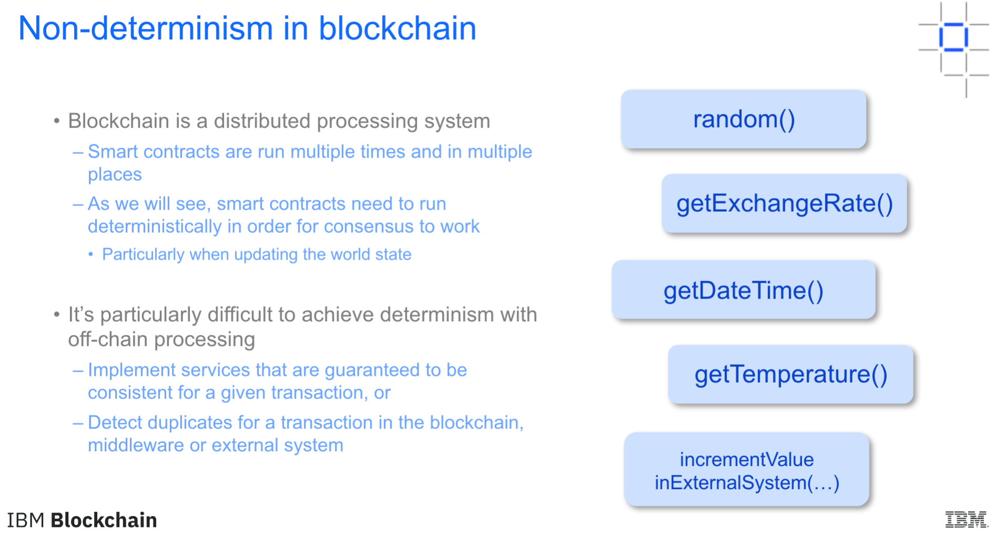
Non-determinism in blockchain

Slide 21
Business Considerations
As a B2B system, blockchain adds a number of aspects that are not typical in other projects:
Who pays for the development and operation of the network?
Where are the blockchain peers hosted?
When and how do new participants join the network?
What are the rules of confidentiality in the network?
Who is liable for bugs in (for example) shared smart contracts?
For private networks, what are the trusted forms of identity?
Remember that each business network participant may have different requirements (e.g. trust)
Evaluate the incentives of potential participants to work out a viable business model
Mutual benefit → shared cost (e.g. sharing reference information)
Asymmetric benefit → money as leveler (e.g. pay for access to KYC)
Notes:
Before any blockchain solution can be built, there are fundamental questions to ask related to how it gets paid for. These are particularly important given the nature of business networks and the importance they give to blockchain.

Slide 22
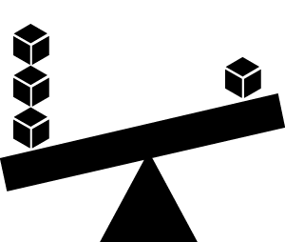
Trade-offs Between Non-Functional Requirements
Performance
The amount of data being shared
Number and location of peers
Latency and throughput
Batching characteristics
Security
Type of data being shared, and with whom
How is identity achieved
Confidentiality of transaction queries
Who verifies (endorses) transactions
Resiliency
Resource failure
Malicious activity
Non-determinism
Consider the trade-offs between performance, security and resiliency!
Notes:
Typically, if you want a blockchain solution to perform fast, you’ll need to trade-off against malicious behaviour. For example, proof of work is very slow but guards against many forms of malicious activity.

Slide 23
Hyperledger Fabric

Slide 24
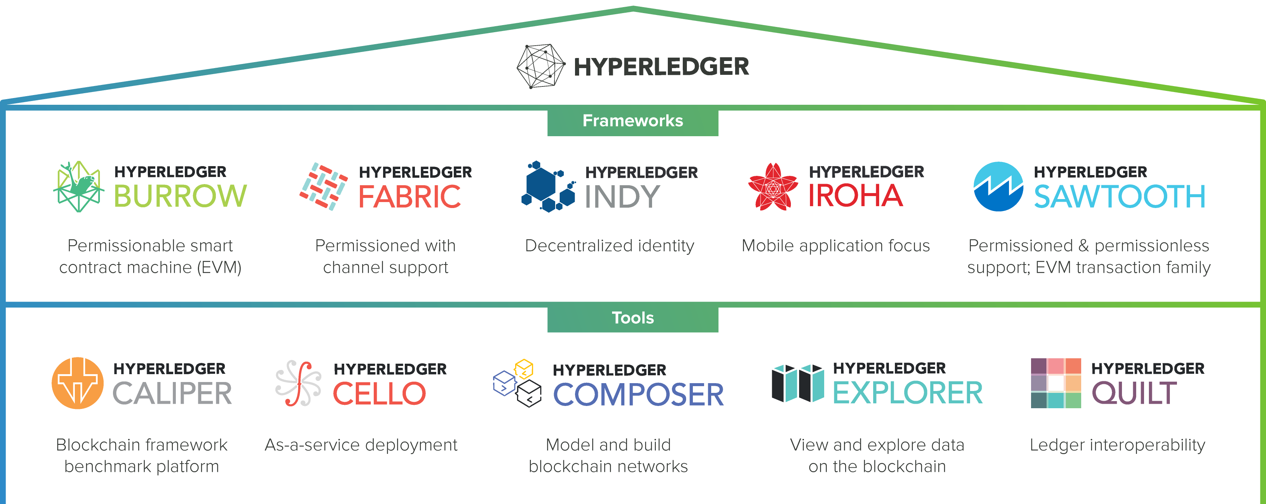
Linux Foundation Open Source Hyperledger
December 2015

Slide 25

Linux Foundation Open Source Hyperledger
App Layer:

Slide 26
Linux Foundation Open Source Hyperledger
App Layer:
Hyperledger Sawtooth Supply Chain
Cargill
https://sawtooth.hyperledger.org/examples/seafood.html

Slide 27
Hyperledger Architecture and Sawtooth Supply Chain
Sawtooth Supply Chain, as the project is provisionally called, breaks new ground because it’s arguably the consortium’s first to really inhabit the application layer of the software stack
Prior to this, Hyperledger confined its work to the lower layers and eschewed the custom-design of blockchain application code with industry players in mind. That job was left to vendors to carry out in a proprietary manner – as IBM has been doing in its now-live food-tracking supply chain platform with the likes of Walmart.
……The approval of Sawtooth Supply Chain as a high-level project massively heightens its profile and means it enters Hyperledger’s formal project lifecycle and receives the support which goes along with that (community outreach, marketing, security review, etc.).
As well as doing engineering further up the stack at the application layer, Sawtooth Supply Chain is the first project sponsored by a non-tech company, U.S. food giant Cargill.
https://www.coindesk.com/ibm-and-intels-brewing-blockchain-tug-of-war
https://github.com/hyperledger/sawtooth-supply-chain

Slide 28
Hyperledger Fabric Now Supports Ethereum Smart Contracts
Enterprise blockchain Hyperledger Fabric has introduced support for Ethereum smart contracts. Fabric is designed to be modular with four main components. These are the main ledger, the consensus mechanism, identity management, and smart contracts called chaincode. The latest announcement provides an alternative to chaincode.
Ethereum’s large pool of developers are comfortable with its Solidity smart contract language, so the integration should make Fabric more appealing to Ethereum developers. Additionally, many coders use Web3 a Node.js set of tools to build Ethereum decentralized apps (Dapps). By integrating with the EVM, these developers can work with Fabric and even migrate smart contracts and Dapps over to Hyperledger Fabric.
https://www.ledgerinsights.com/hyperledger-fabric-integrates-ethereum-smart-contracts-evm-blockchain/

Slide 29
Announcing Hyperledger Grid, a new project to help build and deliver supply chain solutions!
Supply chain is commonly cited as one of the most promising distributed ledger use-cases. Initiatives focused on building supply chain solutions will benefit from shared, reusable tools.
Hyperledger Grid seeks to assemble these shared capabilities in order to accelerate the development of ledger-based solutions for all types of cross-industry supply chain scenarios.
Grid intends to:
Provide reference implementations of supply chain-centric data types, data models, and smart contract based business logic – all anchored on existing, open standards and industry best practices.
https://www.hyperledger.org/blog/2019/01/22/announcing-hyperledger-grid-a-new-project-to-help-build-and-deliver-supply-chain-solutions

Slide 30
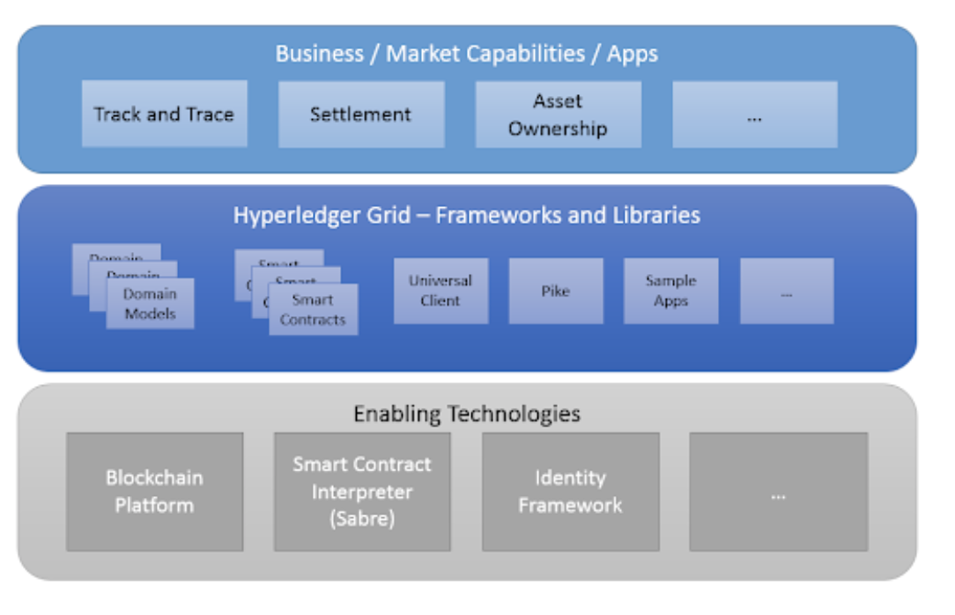
Announcing Hyperledger Grid, a new project to help build and deliver supply chain solutions!
…the use of the Pike Transaction family, which could be used to track the identities of
fish suppliers or diamond handlers, and Sabre, Sawtooth’s native smart contract engine.
Smart contracts in a supply chain context can automatically verify and execute
transactions between any number of businesses.
Identity tracking and Sabre could help expedite the previously cumbersome process
of performing real-world checks on tracked goods.

Slide 31
Enterprise Applications

Slide 32
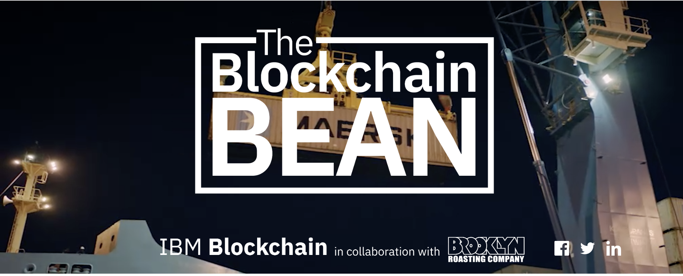
The Blockchain Bean
https://www.ibm.com/thought-leadership/blockchainbean/

Slide 33
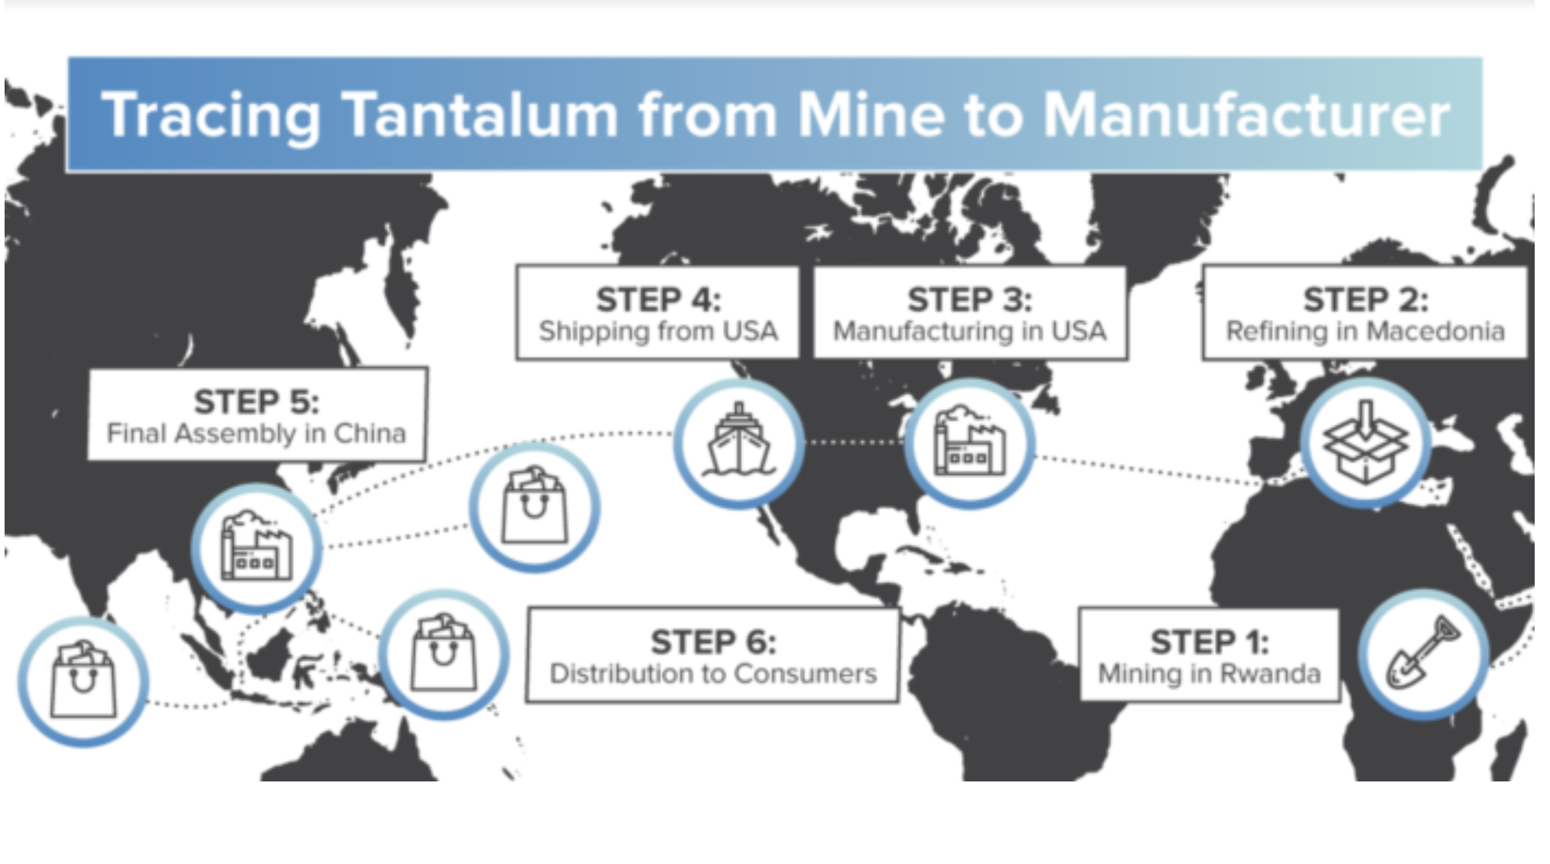
https://www.hyperledger.org/blog/2019/01/24/hyperledger-fabric-in-action-conflict-proofing-tantalum-mining-in-rwanda

Slide 34
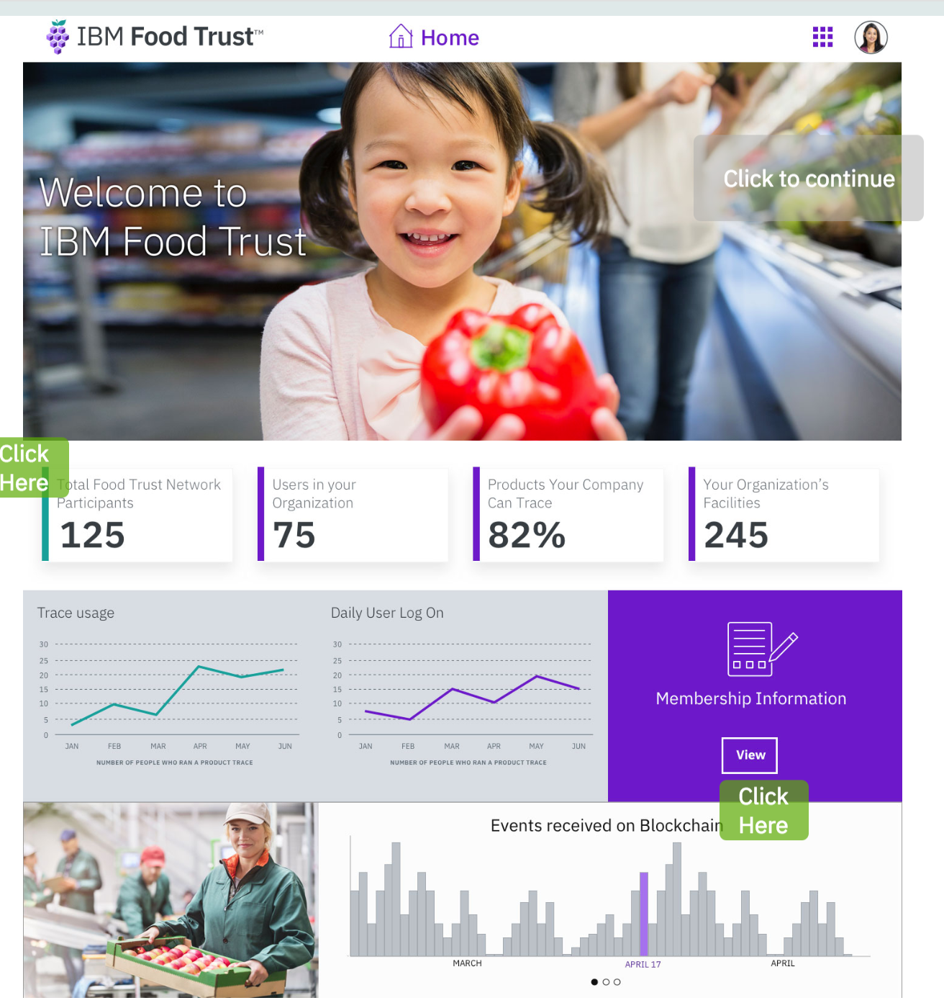
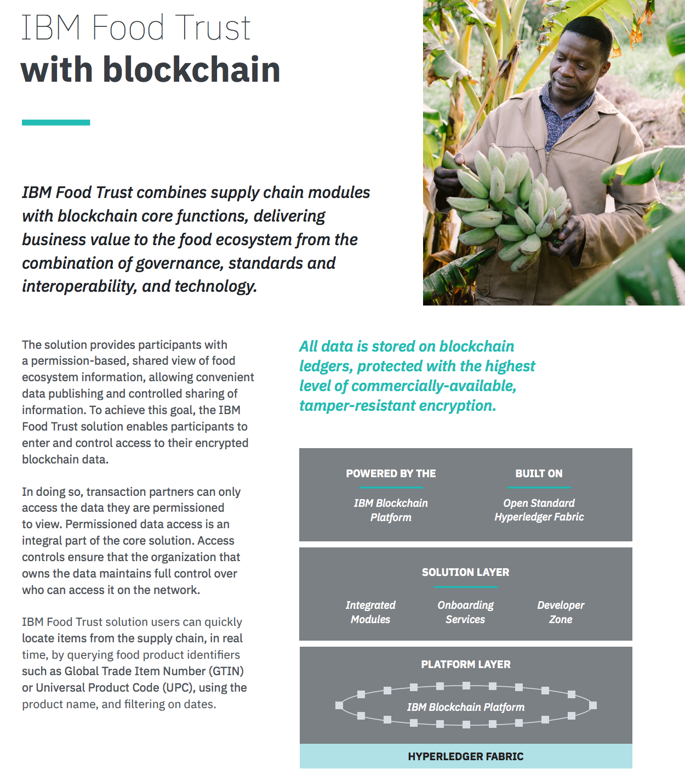
IBM Food Trust
IBM Food Trust
https://www.ibm.com/blockchain/solutions/food-trust
https://www-01.ibm.com/common/ssi/cgi-bin/ssialias?htmlfid=01022001USEN
https://www.ibm.com/thought-leadership/blockchainbean/
https://developer.ibm.com/patterns/track-the-coffee-supply-chain-on-the-blockchain/

Slide 35
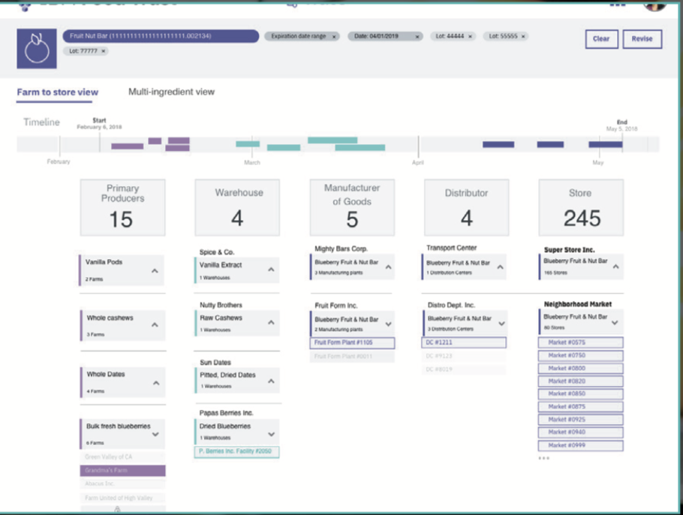
IBM Food Trust architecture
DATA ENTRY AND ACCESS
Leveraging solution and global standards to share data with any network participant authorized by the data owner, you can feel confident knowing your data is shared only with need-to-know business partners in a secure and confidential environment.
CERTIFICATIONS
Digitize business critical certificates and inspection documents to optimize efficiency for information management, certify provenance, and ensure authenticity.

Slide 36
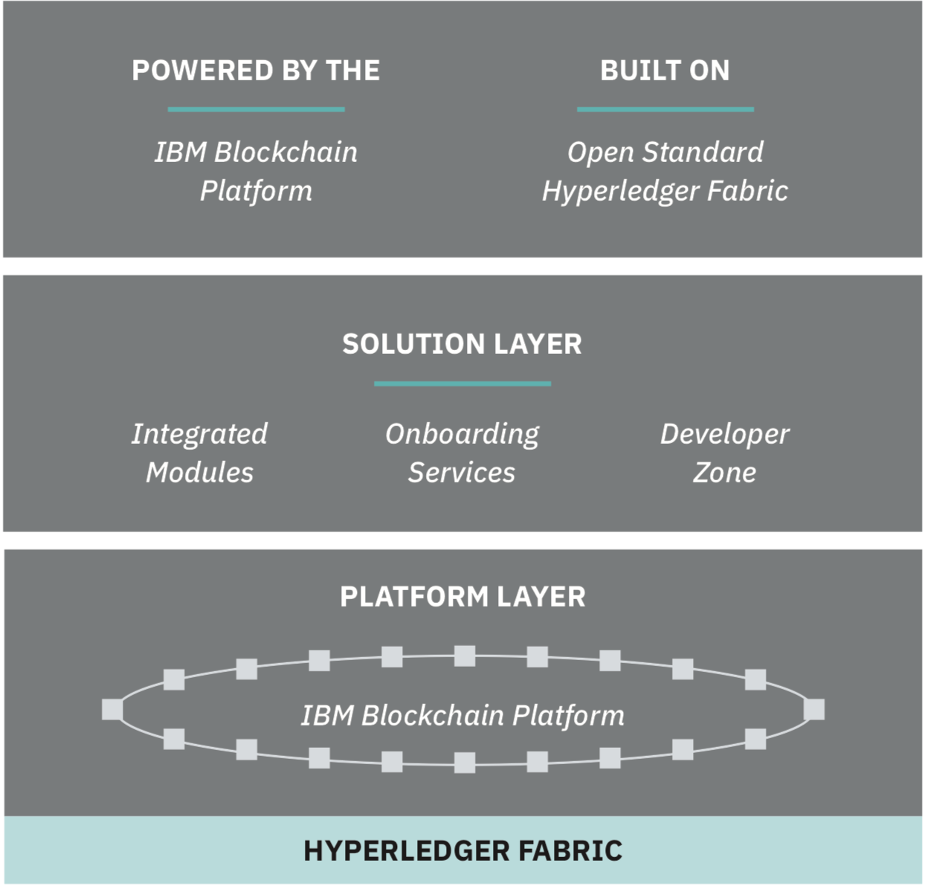
IBM Food Trust architecture
IBM Food Trust solution users can quickly locate items from the supply chain, in real time, by querying food product identifiers such as Global Trade Item Number (GTIN) or Universal Product Code (UPC), using the product name, and filtering on dates.
https://public.dhe.ibm.com/common/ssi/ecm/01/en/01022001usen/about-ibm-food-trust_01022001USEN.pdf

Slide 37
IBM Food Trust architecture
Once you have access to the solution, you will onboard your organization by building and authorizing a team to register and integrate all pertinent information and data.
The IBM Food Trust solution assigns predefined roles that grant users authorization to execute specific network tasks on behalf of their organization.
Assigning roles enables account administrators to easily control the level of access provided to each individual user in their organization.
When onboarding new users to the solution, an account administrator must assign a role to each user:

Slide 38
Tradelens: Digitizing the Global Supply Chain
IBM Blockchain Services: 1500 industry and technical experts
https://cdn2.hubspot.net/hubfs/4989579/TradeLens%20Solution%20Brief:%20Edition%20One.pdf
Brings together all parties in the supply chain — including shippers/BCOs, freight forwarders, inland transportation, ports and terminals, ocean carriers, customs and other government authorities, and more — onto a blockchainbased platform with a secure permission and identity framework.
Documents are stored off chain with only their hashes included in on-chain transactions.

Slide 39
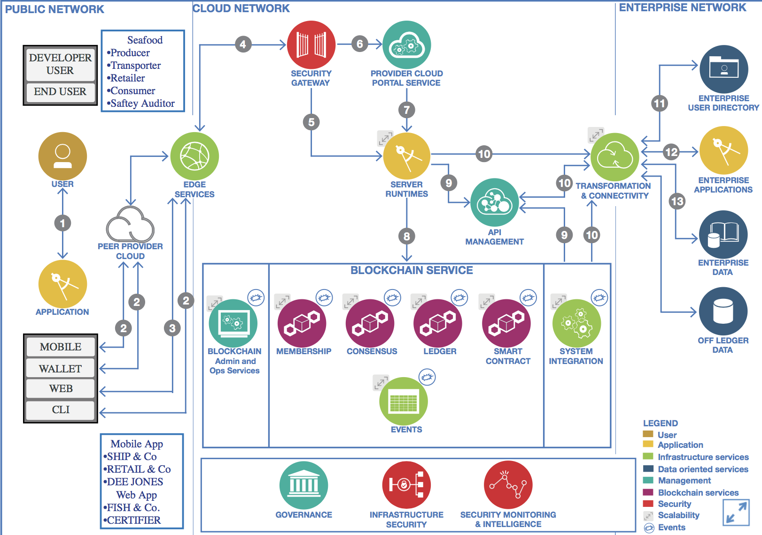
Supply Chain Architecture
https://www.ibm.com/cloud/garage/architectures/blockchainArchitecture/blockchain_supply_chain
https://www.ibm.com/cloud/garage/architectures/blockchainArchitecture/blockchain_supply_chain

Slide 40
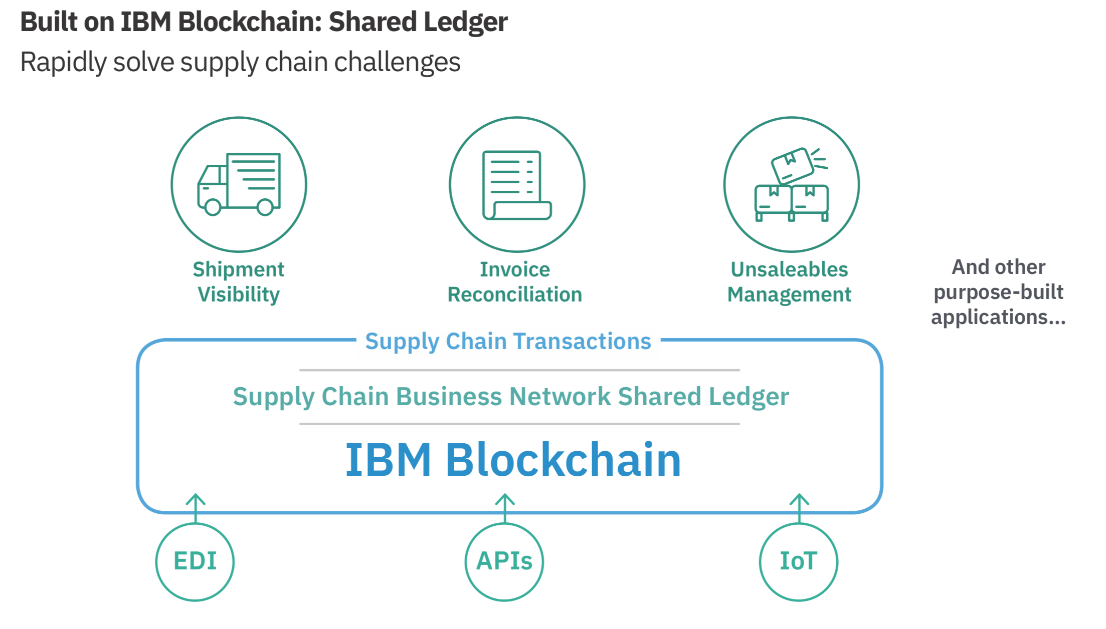
IBM Supplychain Shared Ledger
An immutable shared record of real-time, multi-enterprise digital events powered by IBM Blockchain, on the Supply Chain Business Network
https://www.ibm.com/supply-chain/shared-ledger

Slide 41
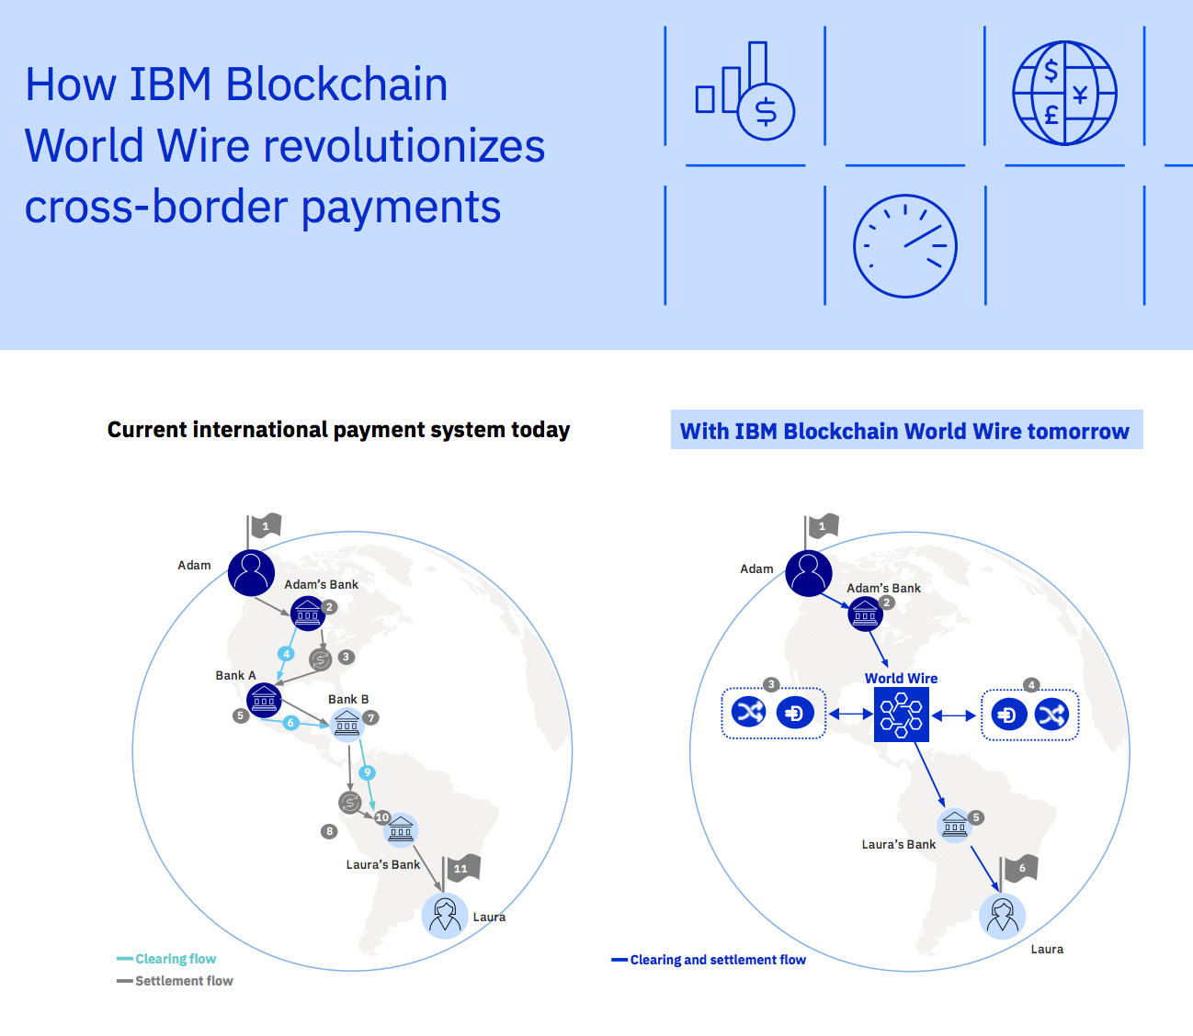
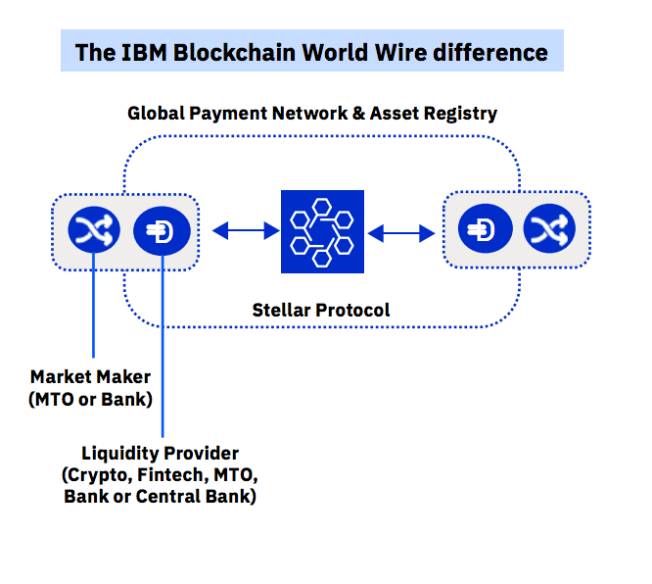
IBM World-Wire

Slide 42
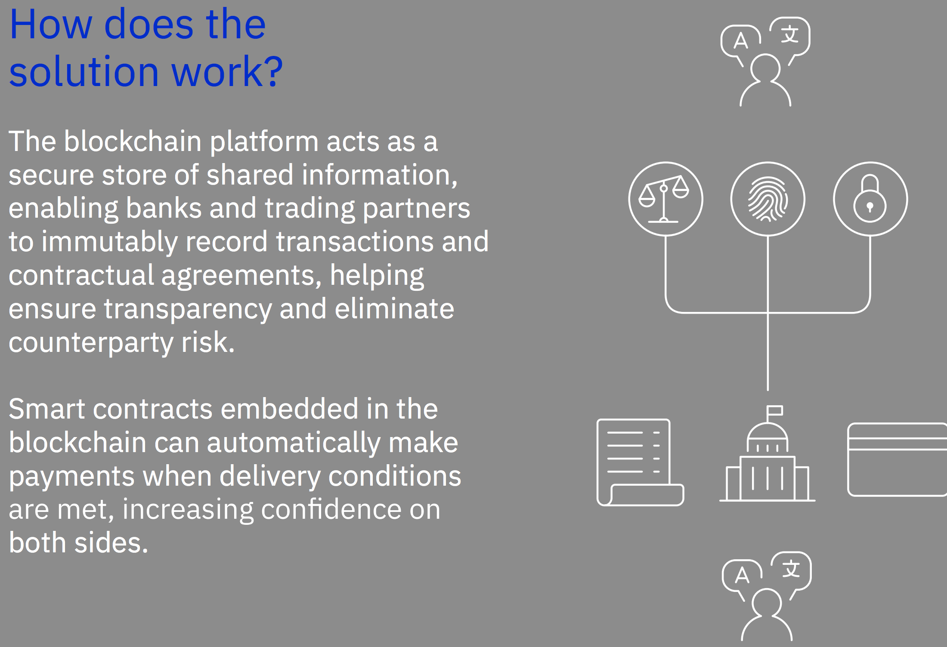
We.trade
https://www-01.ibm.com/common/ssi/cgi-bin/ssialias?htmlfid=62021662USEN

Slide 43
IBM Blockchain Trusted Identity
Trusted identity: the decentralized approach to identity management
Individuals and organizations are often not in control over their own identities. Personal information is regularly shared without awareness and is a centralized source of sensitive data for hackers. Compliance and regulations are also driving change for new identity solutions.
IBM Blockchain Trusted Identity is committed to creating a decentralized approach to identity management – enabled by blockchain – building on top of open standards in combination with Decentralized Identity Foundation (DIF), World Wide Web Consortium (W3C) and other standards groups.
https://www.ibm.com/blockchain/solutions/identity
https://www.ibm.com/blockchain/solutions

Slide 44
Development Tools

Slide 45
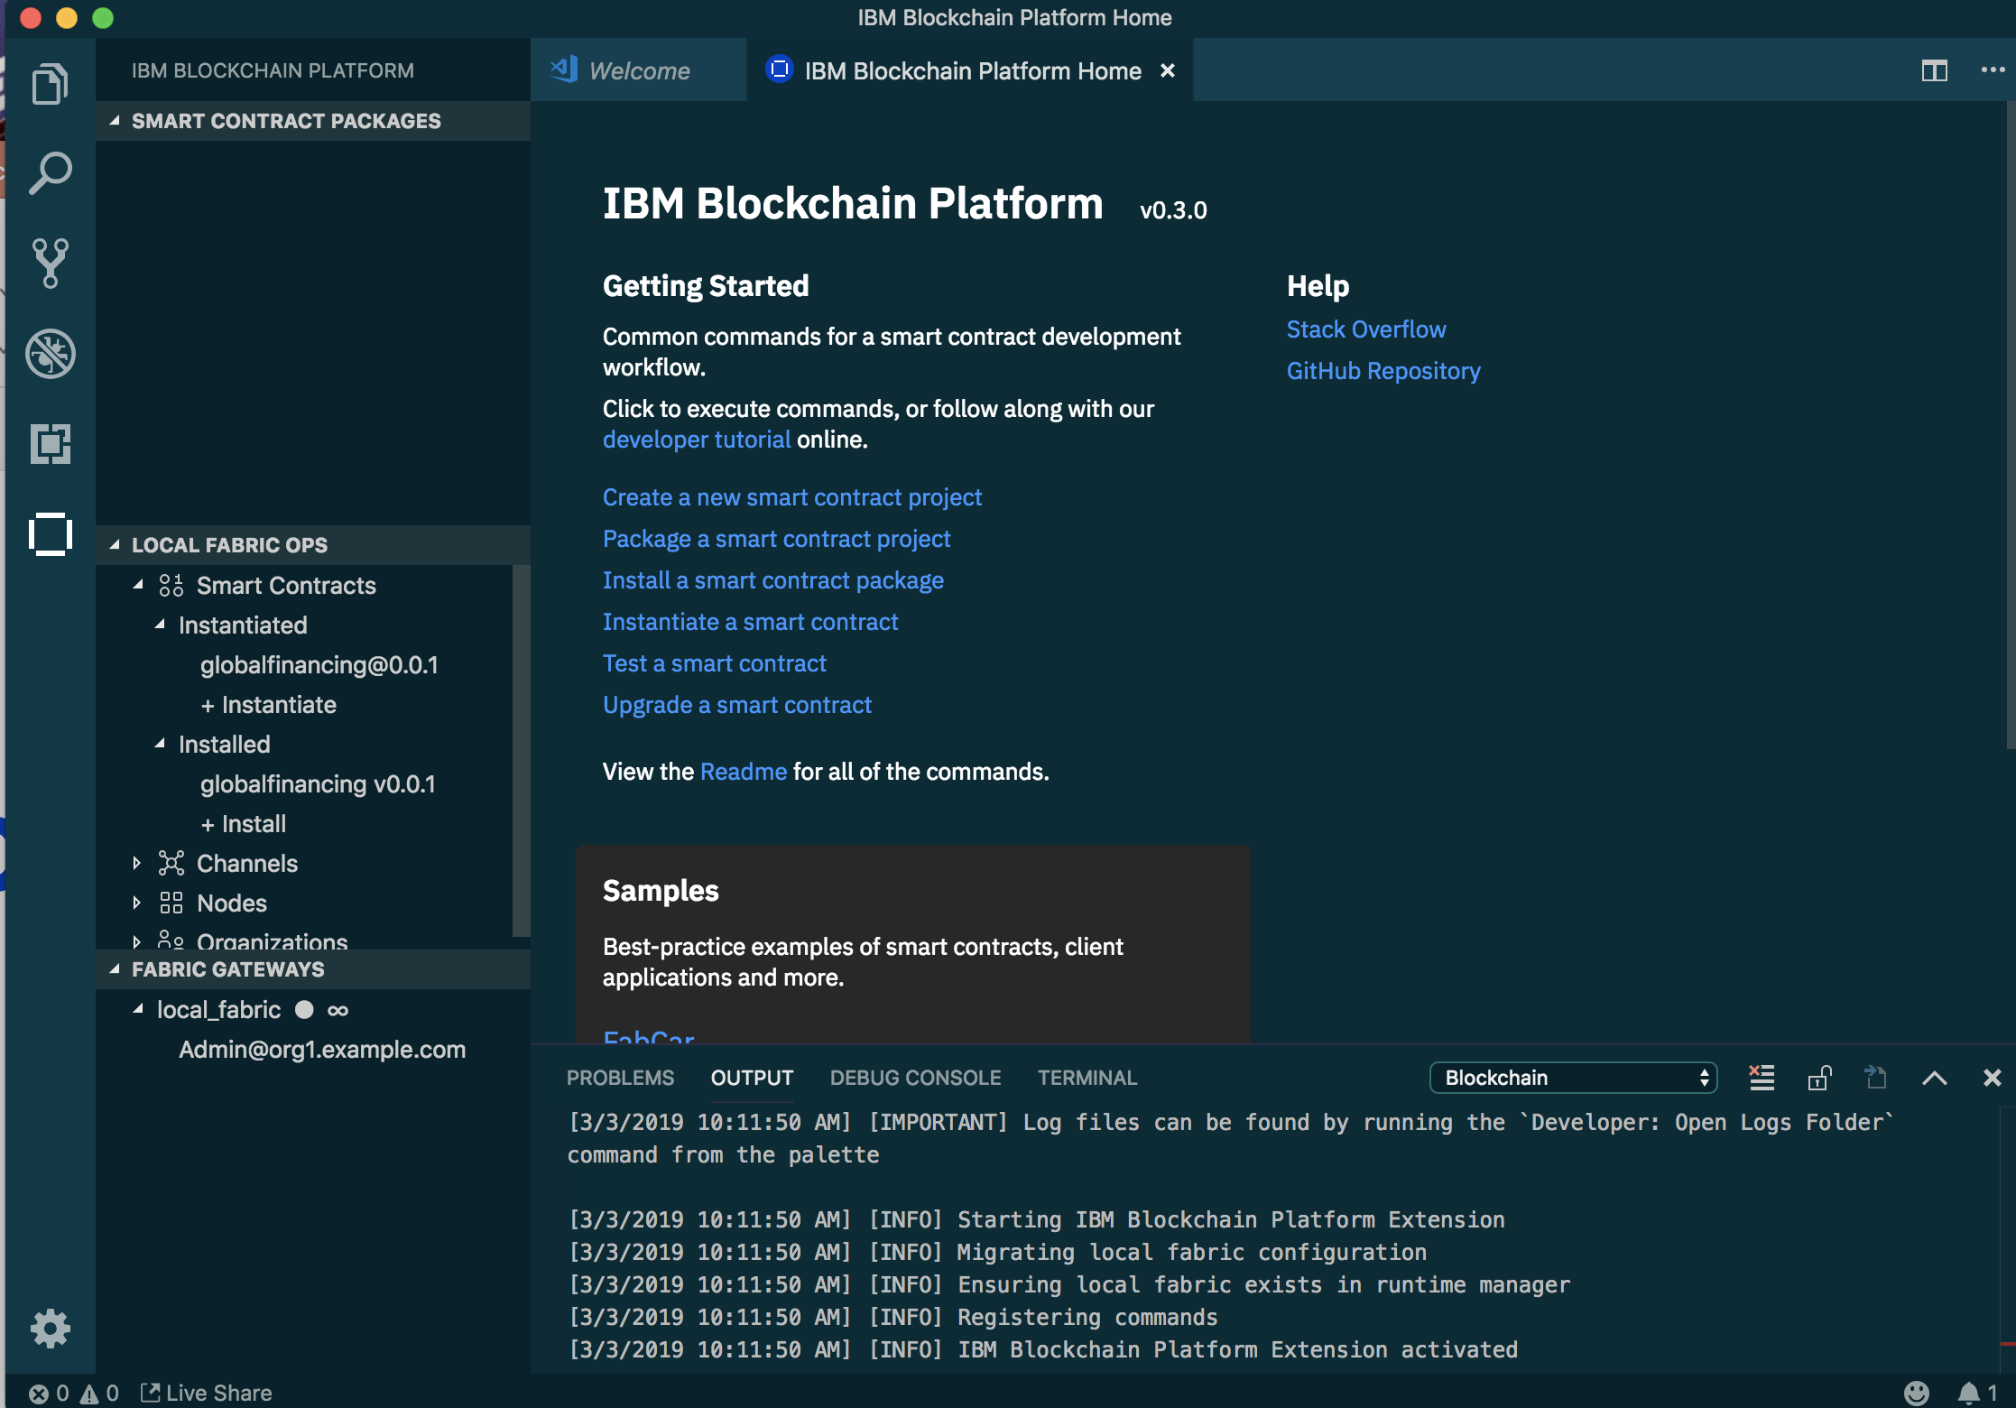
Visual Studio Code

Slide 46
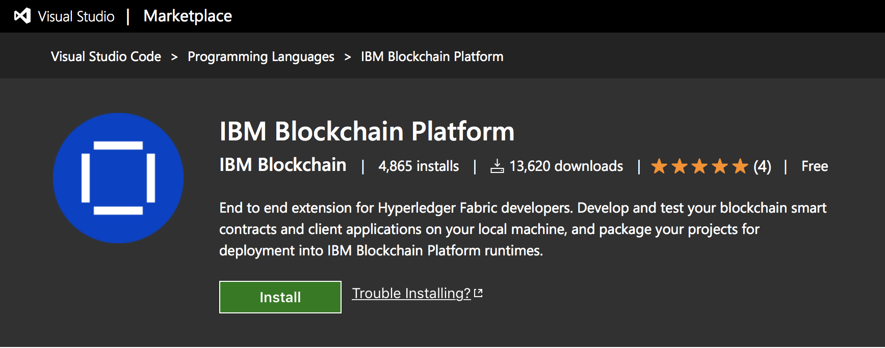
IBM Blockchain Platform for Visual Studio Code
https://marketplace.visualstudio.com/items?itemName=IBMBlockchain.ibm-blockchain-platform

Slide 47
Development Considerations

Slide 48
Hyperledger Fabric Architecture
Architecturally, the fabric is extremely flexible, but in practice consider two recommendations.
First, you only need one or two peers. Per a given channel, peers are identical. They execute the same transactions and receive the same code updates in the exact same order as all other peers on that channel. There is no reason to have lots of peers.
Get two peers if you need the availability – which I would recommend.
Secondly, the front-end systems that hold the Hyperledger SDKs (those systems that provide RESTful interfaces) should be aligned to a member’s peers.
Which means you want your front-end systems talking to your peers and you want other member’s front-end systems talking to their peers.
The idea of an SDK talking to all of the peers for consensus purposes makes little to no sense when they will all return the same results.
One SDK only needs to talk to one peer or two, for high availability, to get the optimal performance and functional capabilities of the fabric.
https://www.ibm.com/blogs/systems/blockchain-how-should-you-organize-your-peers/

Slide 49
Which user roles do you need in a business network?
The consortium owner: This is the organization with the vision for the network, its business benefits and how it will disrupt how business is done. Today, for practical purposes, it is best if there is only one consortium owner, since that entity will be responsible for making the network work.
Members: They are part of the Hyperledger network. They have a peer, which means they can store data, execute chain code (smart contracts), and participate in the consensus process (if the consortium owner allows it). Members bring substance and validity to the network, and it is their data and intelligence that is shared. As the network matures, members can move up in status to become consortium owners.
General users: These are users of the network and they are sponsored and enabled by the consortium owner and the members. They can access and input data, but they do not own data. As with members, as the network matures, general users can become members if they bring value to the network.
https://www.ibm.com/blogs/systems/blockchain-who-should-be-in-your-consortium/

Slide 50


Actors in a Blockchain Solution
Regulator
R
B2B transactions
U
Blockchain
User
A
performs oversight
Blockchain Architect
Blockchain
designs
Membership
Services
D
Blockchain Developer
accesses security certificates
creates applications
access to data
Traditional Data Sources
operates
O
access to logic
Blockchain Network Operator
Traditional Processing Platforms
Notes:
This shows the major actors within a blockchain network and what they are doing within the blockchain. The details are on the next slide.
Presenters might like to hide either this slide or the following one, depending on personal preference.

Slide 51
The Blockchain architect
Domain and Use Case experience
Fundamental grasp of cryptography and Hyperledger
solution architectures
Apply Hyperledger security technologies
Experience with Open source and Blockchain platforms,
including Cryptocurrencies
Technical expertise in Cloud-based blockchain services

Slide 52
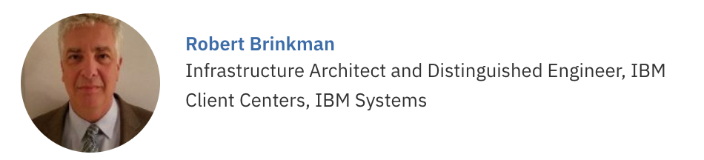
Good IBM Blockchain expert

Slide 53
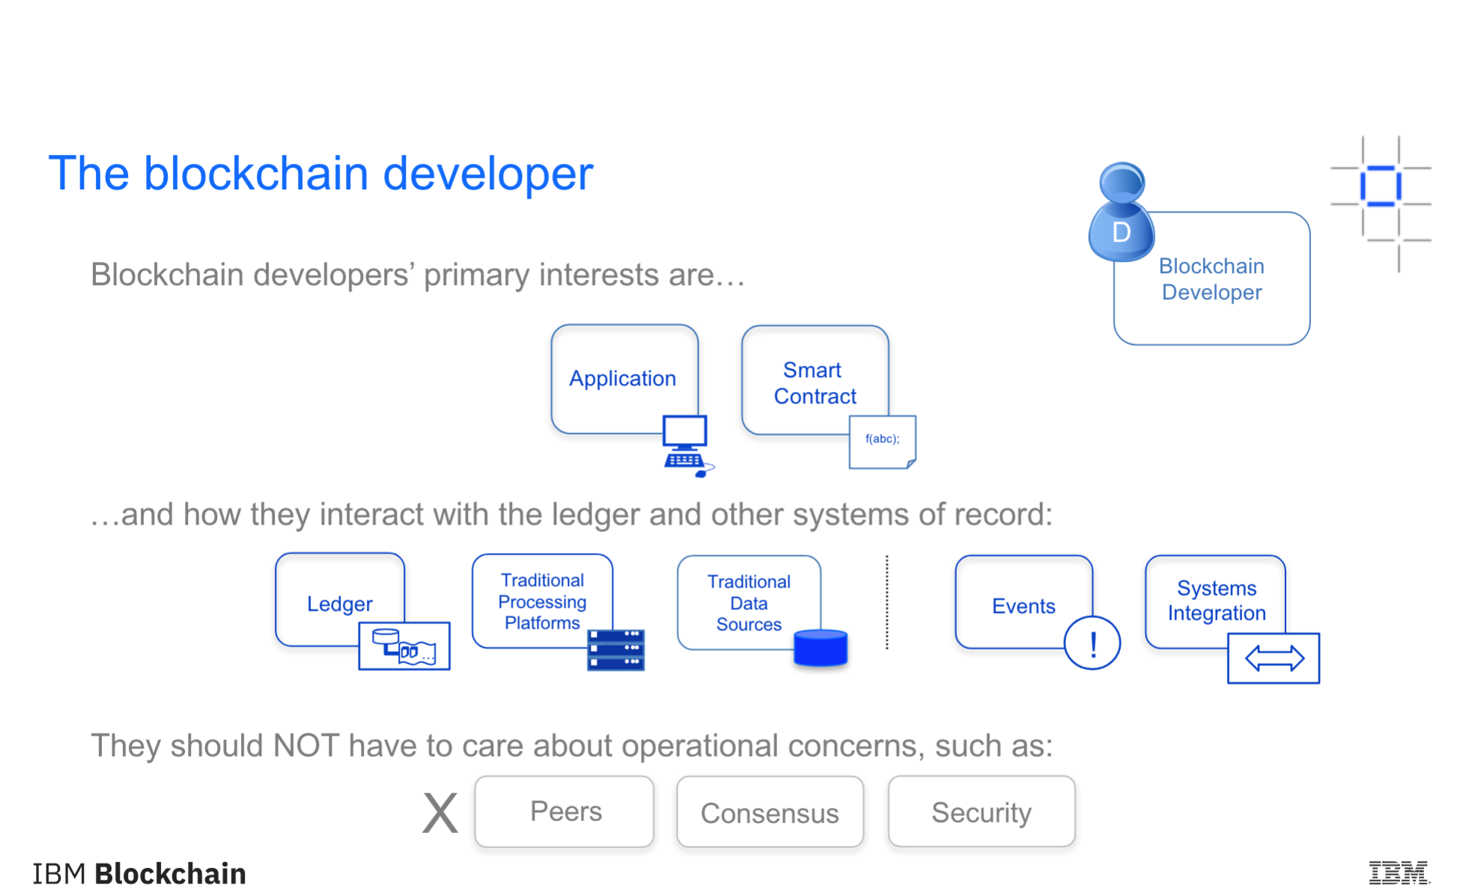
The Blockchain developer

Slide 54
Programming the ledger
Client
Application
Blockchain
developer
develops
D
SDK
develops
submits
PEER
Smart Contract
emits
!
event
accesses
‘get’, ‘put’, ‘delete’
recorded
Ledger
block
txn
txn
txn
emits
!
event
World state
Blockchain
Peer
Notes:
A developer will create an application and smart contract (could be different developers)
The application will invoke calls within the smart contract via an SDK
Those calls are processed by the business logic within the smart contract
- a ‘put’ or ‘delete’ command will go through consensus protocol selected and added to the blockchain
- a ’get’ command can only read from the world state but is not recorded on the blockchain
An application can access Block information via rest APIs such as get block height
Note the use of ‘Delete’ here – delete can delete keys from the world state database, but not transactions from the blockchain, which we’ve established is immutable.

Slide 55
Fabric Ledger
The Fabric ledger is maintained by each peer and includes the blockchain and worldstate
A separate ledger is maintained for each channel the peer joins
Transaction read/write sets are written to the blockchain
Channel configurations are also written to the blockchain
The worldstate can be either LevelDB (default) or CouchDB
LevelDB is a simple key/value store
CouchDB is a document store that allows complex queries
The smart contact Contract decides what is written to the worldstate
Config Block
0
Config
Block
1
Transaction
Block
2
Transaction
Block
3
Worldstate
Genesis
Blockchain

Slide 56

Domain of the Blockchain operator
External-CA
Fabric-CA
optional
Membership
Services
optional
Admin
Peer
Endorser
Client
Application
SDK (HFC)
Committer
O
O
Ledger
Chaincode
A
B
O
O
Events
!
Ordering-Service
Hyperledger Fabric Network

Slide 57
Hyperledger Fabric components
Hyperledger has three components:
Membership services – which manages digital certificates and access,
ordering service – which keeps the peers in alignment,
and peers – which hold the ledger.
A peer is also where chaincode, also known as smart contracts, are executed.
Membership and ordering services align well to being centralized.
Peers, on the other hand, can be distributed and placed anywhere you desire in the world.
Each member of the Hyperledger network should have their own peer.
The channels (databases) that a peer subscribes to, and transacts against, determines the member’s role and capabilities in the blockchain network.
https://www.ibm.com/blogs/systems/blockchain-how-should-you-organize-your-peers/

Slide 58
IBM Cloud and
Hyperledger SaaS

Slide 59
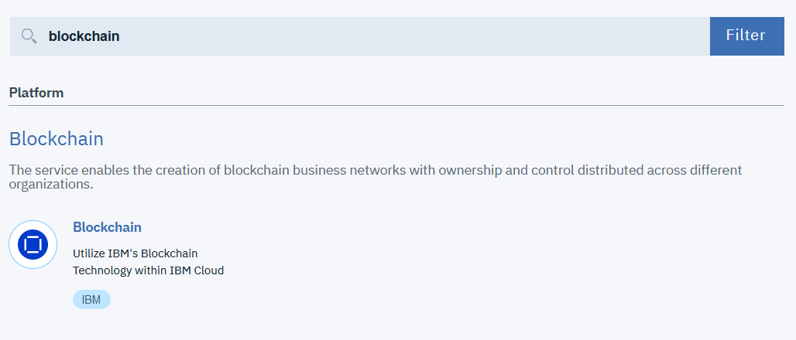

Slide 60
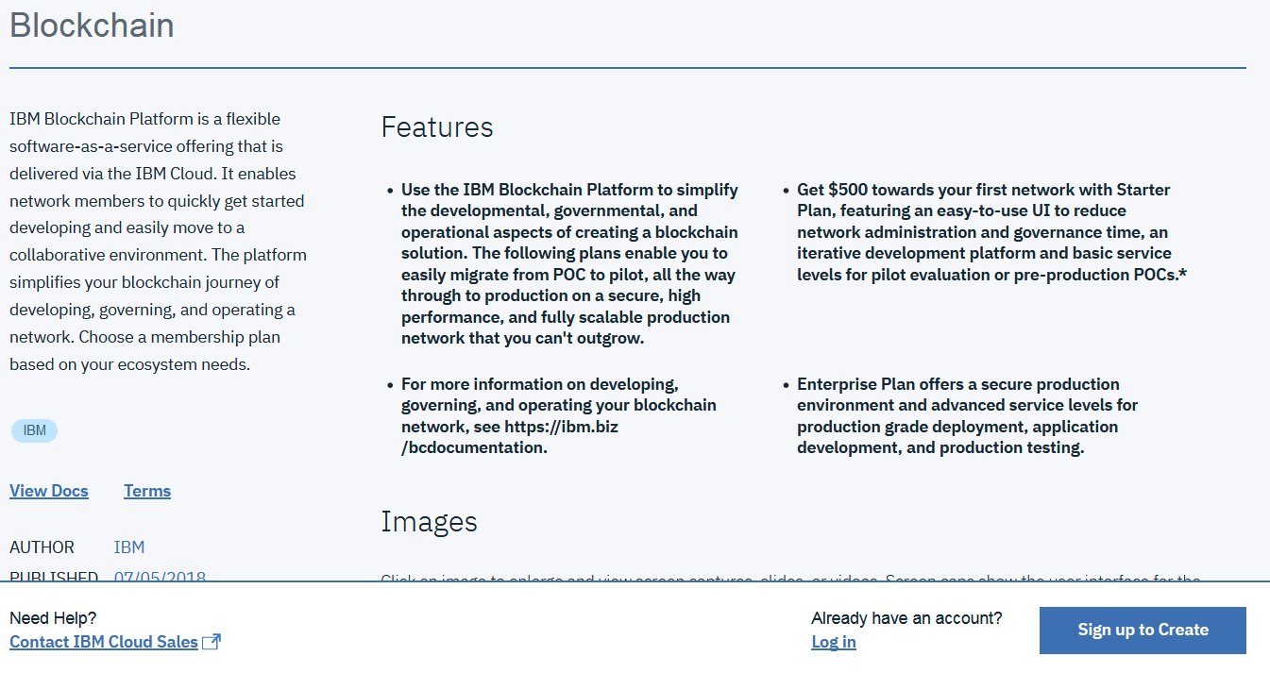

Slide 61
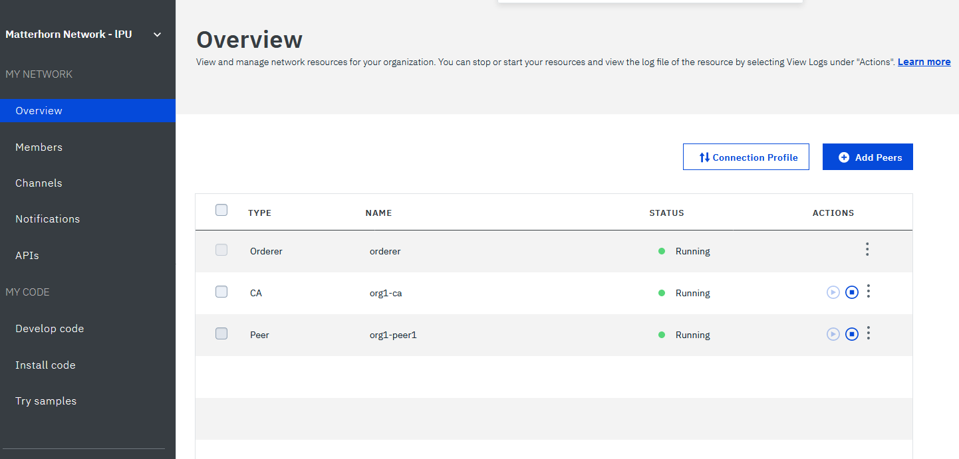

Slide 62
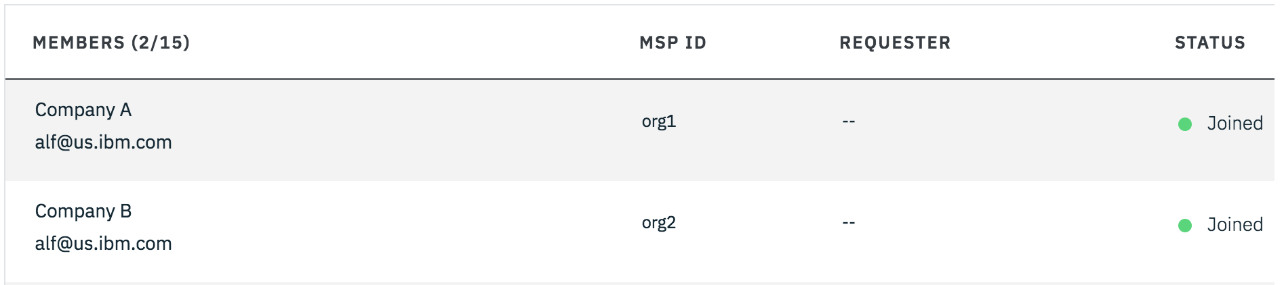
Members

Slide 63
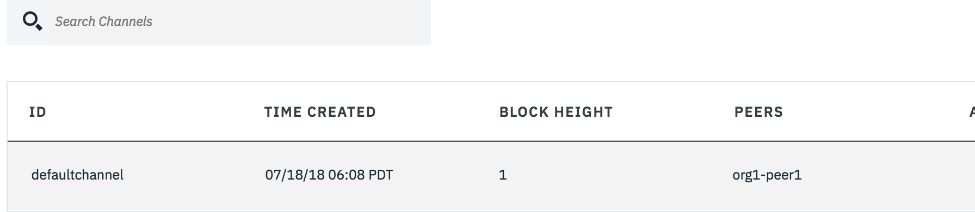
Channels

Slide 64
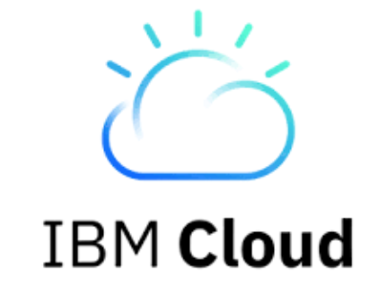
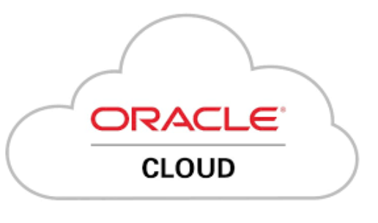


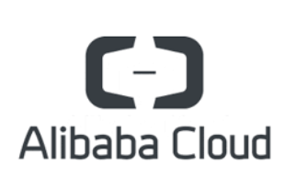
How do we host our Blockchain application?

Slide 65
Where do we go from here?
LinkedIn: lennartfrantzell
IBM Blockchain: https://www.ibm.com/blockchain
Build for free on IBM Cloud: https://ibm.biz/Bd2L5W
Startup with IBM. Build. Scale. Win.
With $120,000 in free IBM Cloud credits, Startup with IBM can put your business on the path to transformative growth. Disrupt your industry with IBM.
https://developer.ibm.com/startups/

Slide 66
Thank you
Lennart Frantzell
www.ibm.com/blockchain
developer.ibm.com/blockchain
www.hyperledger.org
© Copyright IBM Corporation 2017. All rights reserved. The information contained in these materials is provided for informational purposes only, and is provided AS IS without warranty of any kind, express or implied. Any statement of direction represents IBM's current intent, is subject to change or withdrawal, and represents only goals and objectives. IBM, the IBM logo, and other IBM products and services are trademarks of the International Business Machines Corporation, in the United States, other countries or both. Other company, product, or service names may be trademarks or service marks of others.

